Slide 1

ClickMeeting Deep Packet Inspection
Gufran Yesilyurt
Notes:
Hi everyone! I hope you are well. I am Gufran Yeşilyurt. Today I am going to present my Deep Packet Inspection about ClickMeeting. But first, it is good to know what is ClickMeeting?

Slide 2
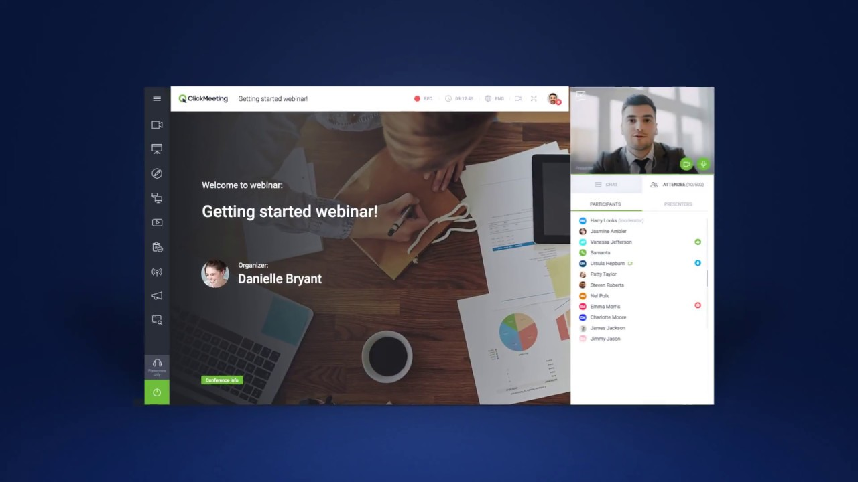
Technologies
Setup
Live Meeting
Live Webinar
On-demand
Results
What is ClickMeeting?
Notes:
ClickMeeting is basically a platform that makes easier to host different type of webinars.

Slide 3
"Вебінарна кімната ClickMeeting має багато функцій, які добре використовуються та покращують привабливість занять. Грамотно розроблений онлайн-урок із застосуванням гарних інструментів дозволяє передати знання по-новому, надаючи учням нові стимули, завдяки чому вони більш відкриті до набутих знань." (Перцев, 2018)
Technologies
Setup
Live Meeting
Live Webinar
On-demand
Results
"The ClickMeeting webinar room has many functions that are well used and
improve the attractiveness of the classes. A well-designed online lesson with the use of good
tools allows one to transfer knowledge in a new way, providing students with new incentives,
thanks to which they are more open to the acquired knowledge" (Pertsev, 2018)
Notes:
There was only research about ClickMeeting’s impact on education in Ukrainian. It was commonly used in Poland and other European countries due to the Covid crisis.

Slide 4
Key Concepts
Technologies
Setup
Live Meeting
Live Webinar
On-demand
Results
Technologies
On-demand Webinar
Technologies & Protocols
1
Experimental Setup
Results
Experimental Setup
2
Live Meeting
Inspection of Packets
3
Live Webinar
Notes:
Today we are going to start with inspecting technologies that are used by ClickMeeting, and hopefully, we are going to understand them. Then I am going to explain how I captured the packets and the things that I pay attention to while I am capturing. After the experimental setup, we are going to analyze different types of webinars and at the end, we will see the results of these analyzes.

Slide 5
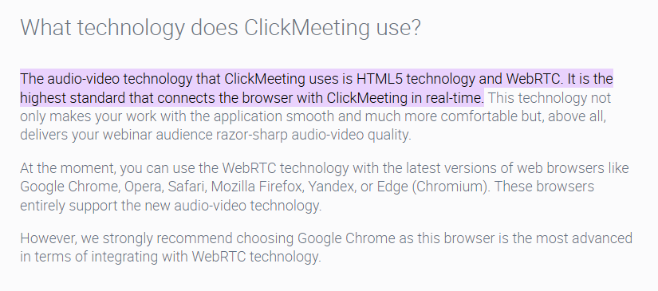
Technologies
Setup
Live Meeting
Live Webinar
On-demand
Results
01.
Technologies
HTML5 - webRTC
Notes:
So, let’s start with the technologies.

Slide 6
Technologies
Technologies
Setup
Live Meeting
Live Webinar
On-demand
Results
HTML5
webRTC
HTML5 is a markup language used for structuring and presenting content on the World Wide Web.
webRTC is a technology that enables Web sites to capture and optionally stream audio and/or video media.
Notes:
ClickMeeting uses HTML5 and webRTC. As most of you know these technologies make it much easier to stream videos and audio on browsers due to the codecs they support. In fact that you can use ClickMeeting from browser hence these technologies create an advantage while hosting webinars. But let’s take a closer look at these technologies.

Slide 7
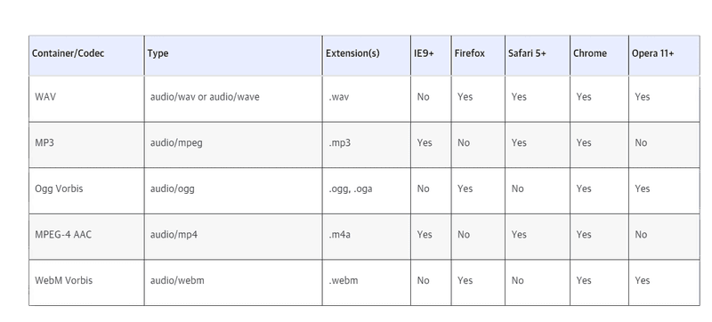
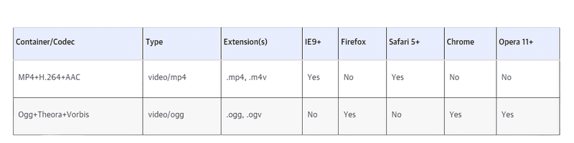
Historia
Technologies
Setup
Live Meeting
Live Webinar
On-demand
Results
HTML5
Codecs
The ClickMeeting supports most of the Video and Audio codecs by HTML5.
Responsive
Provides an opportunity to video/audio stream on mobile devices, desktops, and websites.
Notes:
Here you can see the codecs supported by HTML5. Thanks to these codecs today we are able to encode and decode our data on browsers. As an example, an MP3 codec is used to create MP3 files from audio data. To play that MP3 file back on a computer or separate device, you'll need a codec that can decode the format.

Slide 8
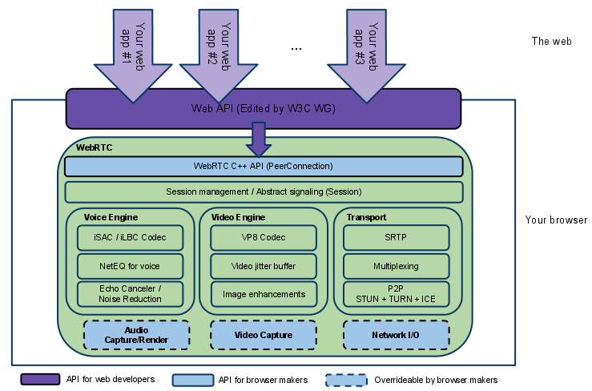
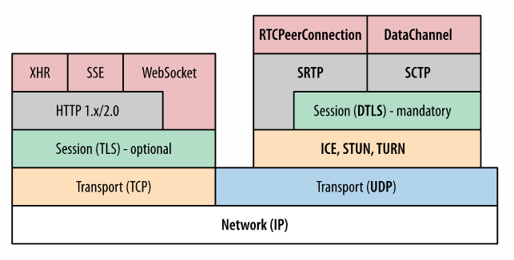
Historia
Technologies
Setup
Live Meeting
Live Webinar
On-demand
Results
webRTC
Architecture
WebRTC architecture consists of over a dozen different standards, covering both the application and browser.
Protocols
Unlike all other browser communication that use Transmission Control Protocol (TCP), WebRTC transports its data over User Datagram Protocol (UDP).
Notes:
webRTC looks actually more complicated. You can see the APIs and Protocols that are used by webRTC. I guess most of you are familiar with UDP and TCP so let’s examine why these are having importance in this presentation.

Slide 9
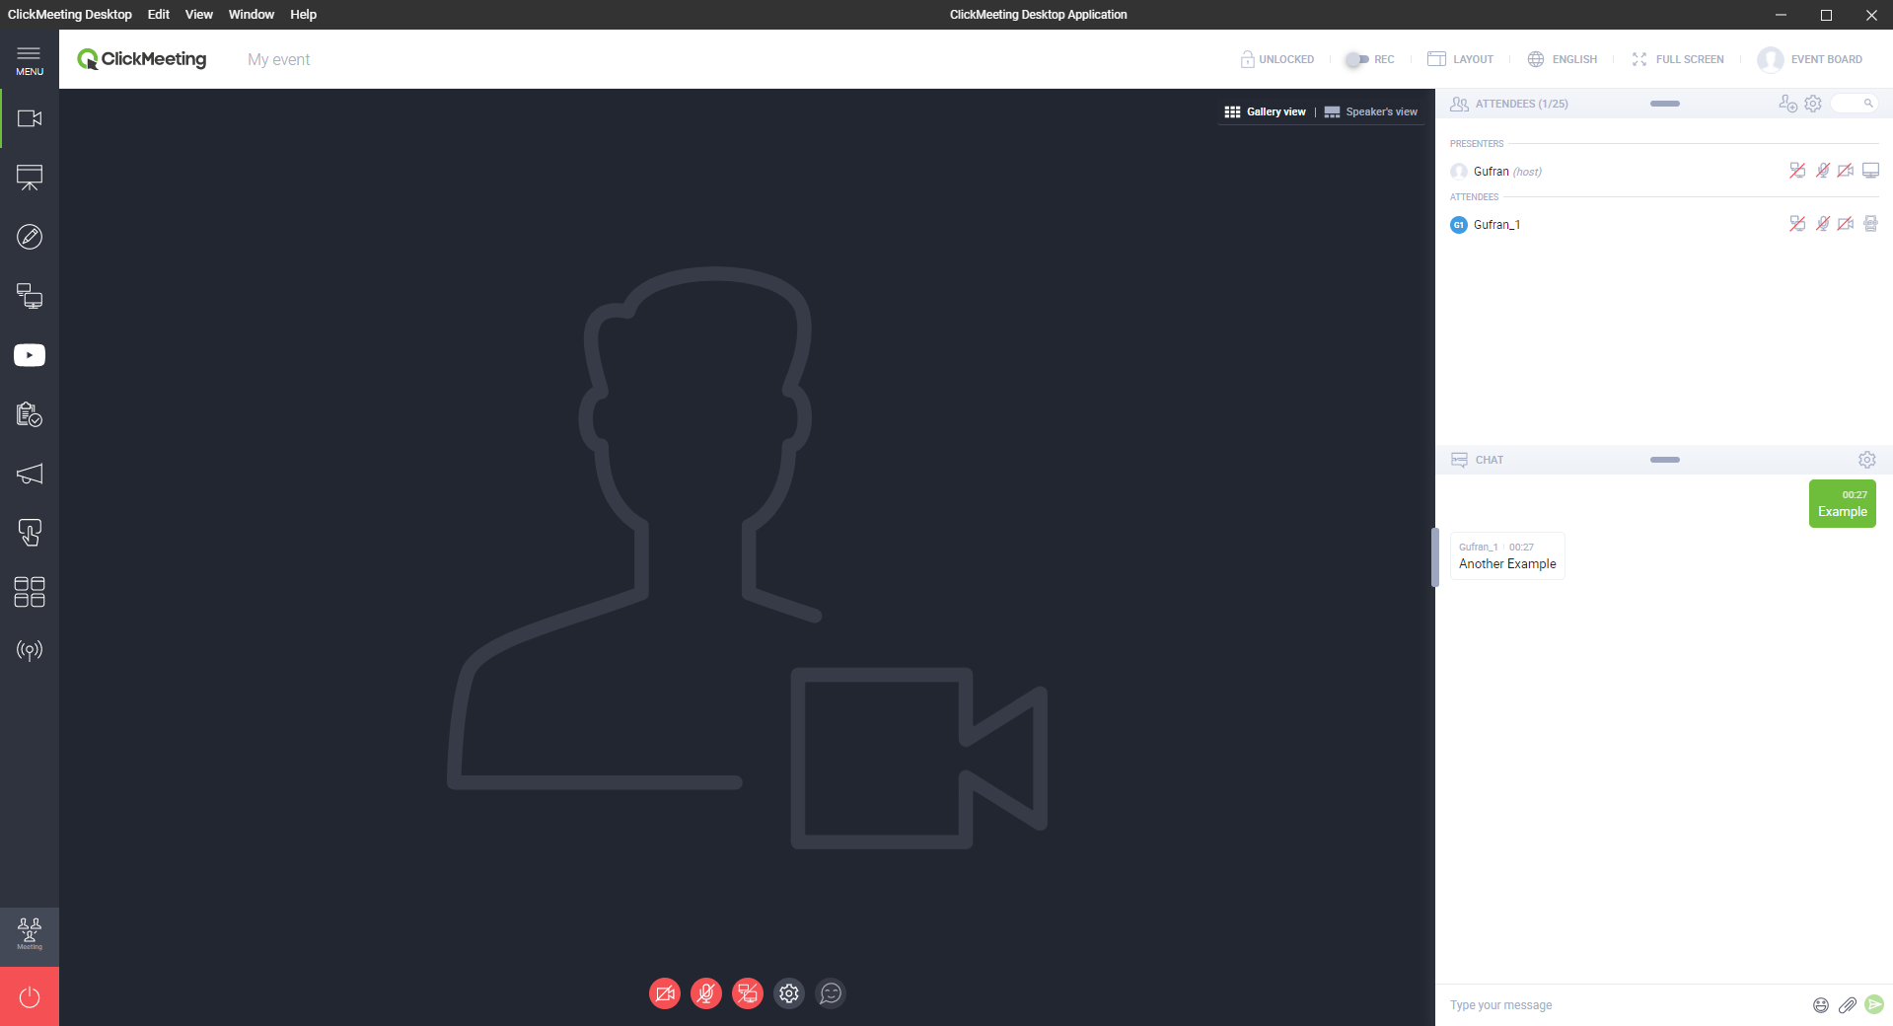
Browser vs Desktop
Technologies
Setup
Live Meeting
Live Webinar
On-demand
Results
Browser: UDP, STUN, DTLS, SDP
Desktop: TCP, STUN, TLS
Notes:
Because webRTC and HTML5 are used by the browser side, there are some differences with the desktop application. While capturing packets, I noticed that the desktop application transports data over TCP so to understand this difference I chose to inspect it instead of the browser. But of course, there were some other reasons when I made this decision.

Slide 10
Easy
Connected
Desktop traffic is easy to isolate rather than browser traffic.
Still, some parts are connected to the website.
Notes:
Desktop traffic was way easier to isolate and there were still some parts connected to the browser so it was not different from all aspects.

Slide 11

Technologies
Setup
Live Meeting
Live Webinar
On-demand
Results
02.
Experimental Setup
Wireshark – TCPView – netstat
Notes:
Now let’s take a look at how I started to capture and inspect these packets. Of course, it was with Wireshark but there are other tools that are worth mentioning.

Slide 12
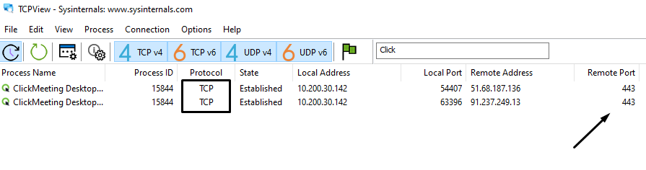
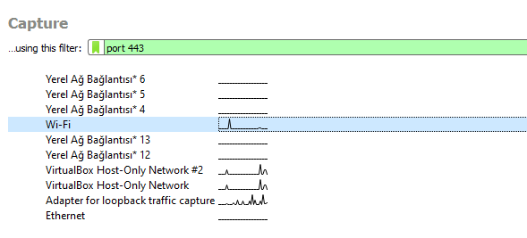
Tools
Technologies
Setup
Live Meeting
Live Webinar
On-demand
Results
Find which ports are used by the application (TCPView).
a.
As an alternate to TCPView, find ports by netstat command.
b.
Filter the port in Wireshark and capture packets.
c.
Notes:
Before starting, I can say that as an alternate solution I could use a virtual machine but I had some issues with my virtual machine so I chose this method. In order to isolate network traffic, I had to filter it. So I thought I need to know which port this application uses. If you want to find that you can use TCPView developed by Microsoft or if you like to have dirt in your hands and want to use terminal you can use netstat command to observe port used by proccesses. After that you can easily filter the network traffic by port in Wireshark.

Slide 13
Pcap Files
Technologies
Setup
Live Meeting
Live Webinar
On-demand
Results
Live Meeting
Live Webinar
On-Demand
Chat, Voice, and Video call with attendees at the same time.
Chat with attendees but only the presenter’s voice and video stream.
Pre-recorded stream broadcasts.
Notes:
ClickMeeting doesn’t let you write messages or just voice chat, you must attend a webinar or a meeting so it was not quite easy to detect transitions between chat, voice, and video. That’s why I decided to inspect the differences between different webinar and meetings types. As you can see in the slide, there are different features provided by different types of meetings.

Slide 14
Technologies
Setup
Live Meeting
Live Webinar
On-demand
Results
03.
Live Meeting
Packet Behavior & Features
Notes:
Let’s start with the Live Meeting. This is the meeting type that we are currently doing.

Slide 15
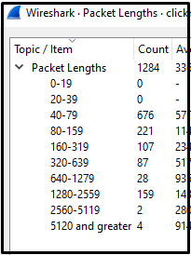
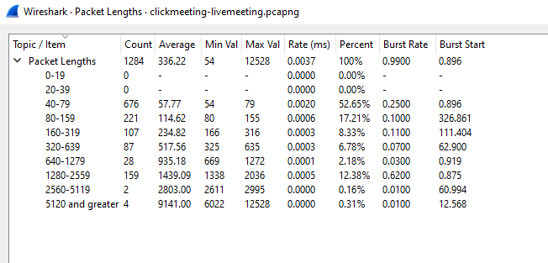
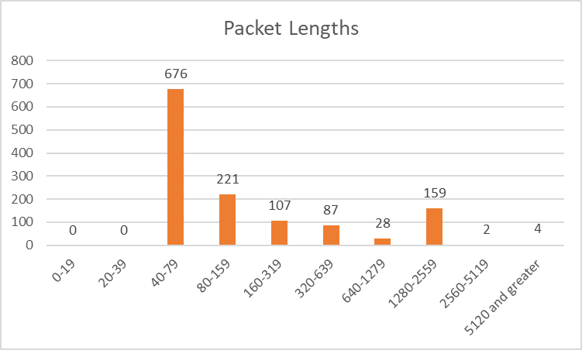
Packet Lengths
Technologies
Setup
Live Meeting
Live Webinar
On-demand
Results
Notes:
As most of you would expect, the lengths of most packets are smaller. This is mostly because of the concerns about packet loss and transportation speed. That’s why in live meetings packets must be smaller.

Slide 16
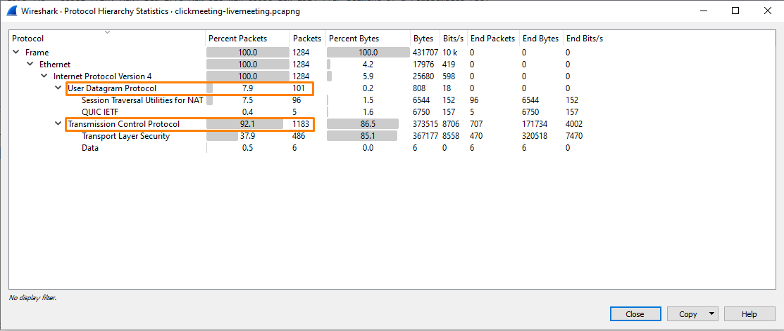
Protocol Hierarchy
Technologies
Setup
Live Meeting
Live Webinar
On-demand
Results
Notes:
As I have mentioned before, the desktop application sends most of the data over TCP. Also, you may notice that most of the UDP packets are from STUN. The STUN server allows clients to find out their public address, this information is used to set up UDP communication between the client and the VoIP provider to establish a call.

Slide 17
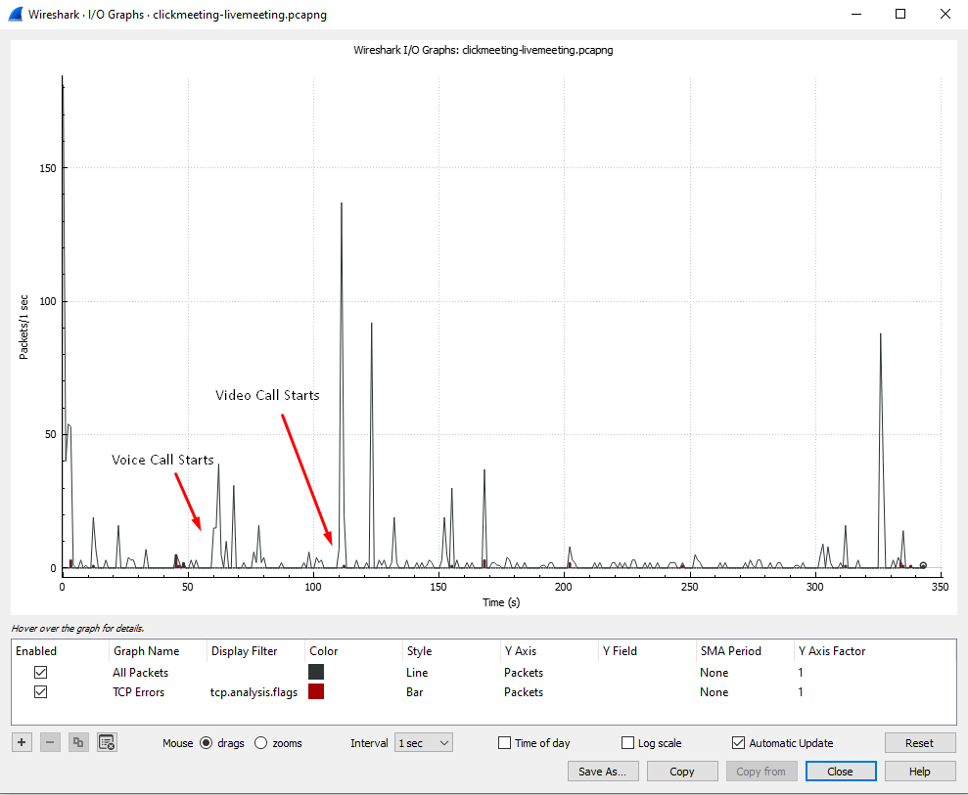
I/O Graph
Technologies
Setup
Live Meeting
Live Webinar
On-demand
Results
TCP errors (red bars) are not common so these are normal events. They do not impact application and/or performance across the network.
Notes:
When we look at the I/O Graphs we can see the packets over time. These arrows indicate the times that I open my mic and video. It is also possible to colorize packets by their protocol but in this case, it is mostly TCP. Also, we can check the packet losses indicated by red bars but there are not many due to the good connection performance.

Slide 18
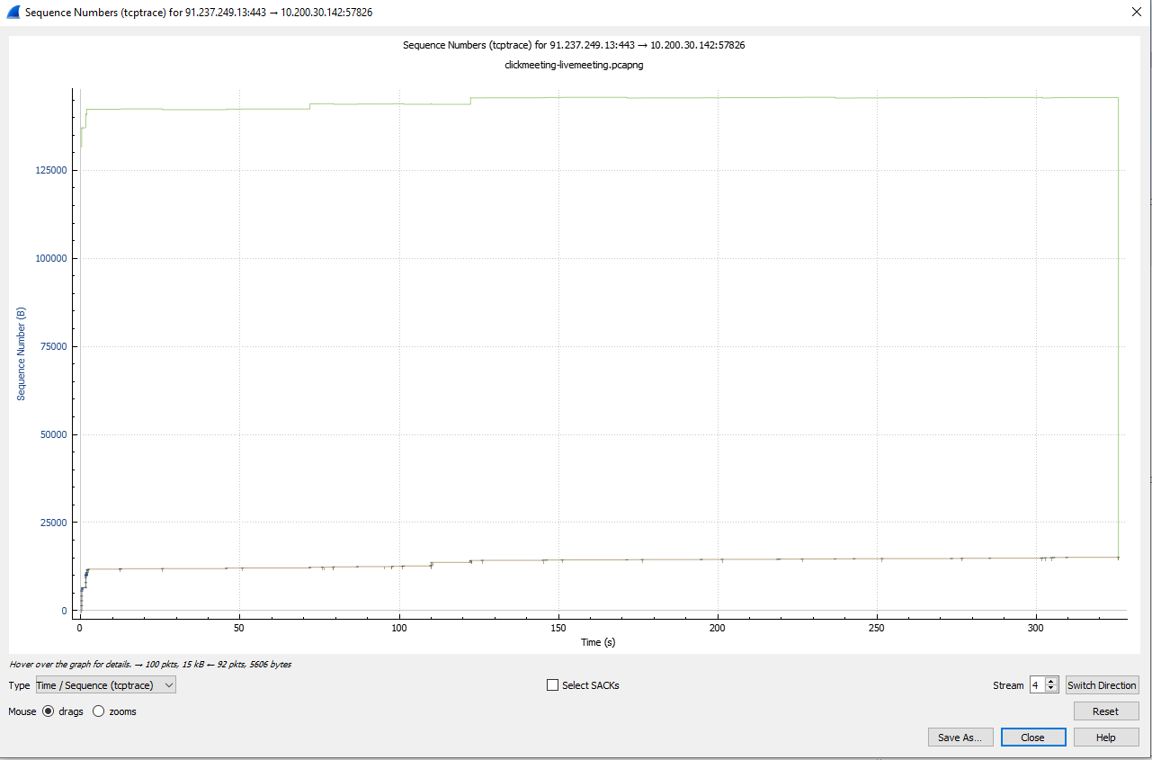
TCP Trace
Technologies
Setup
Live Meeting
Live Webinar
On-demand
Results
Green Line: 10.200.30.142 Calculated Receive Window
Brown Line: Acknowledged Data
Notes:
AT TCP Trace Graphs we can inspect transmitted data. You may wonder what is the calculated receive window. Simply put, it is a TCP receive buffer for incoming data that has not been processed yet by the application. This field tells how much data can be sent on the wire before an acknowledgment is received. If the receiver is not able to process the data as fast as it arrives, gradually the receive buffer will fill and the TCP window will be reduced in the acknowledgment packets.

Slide 19
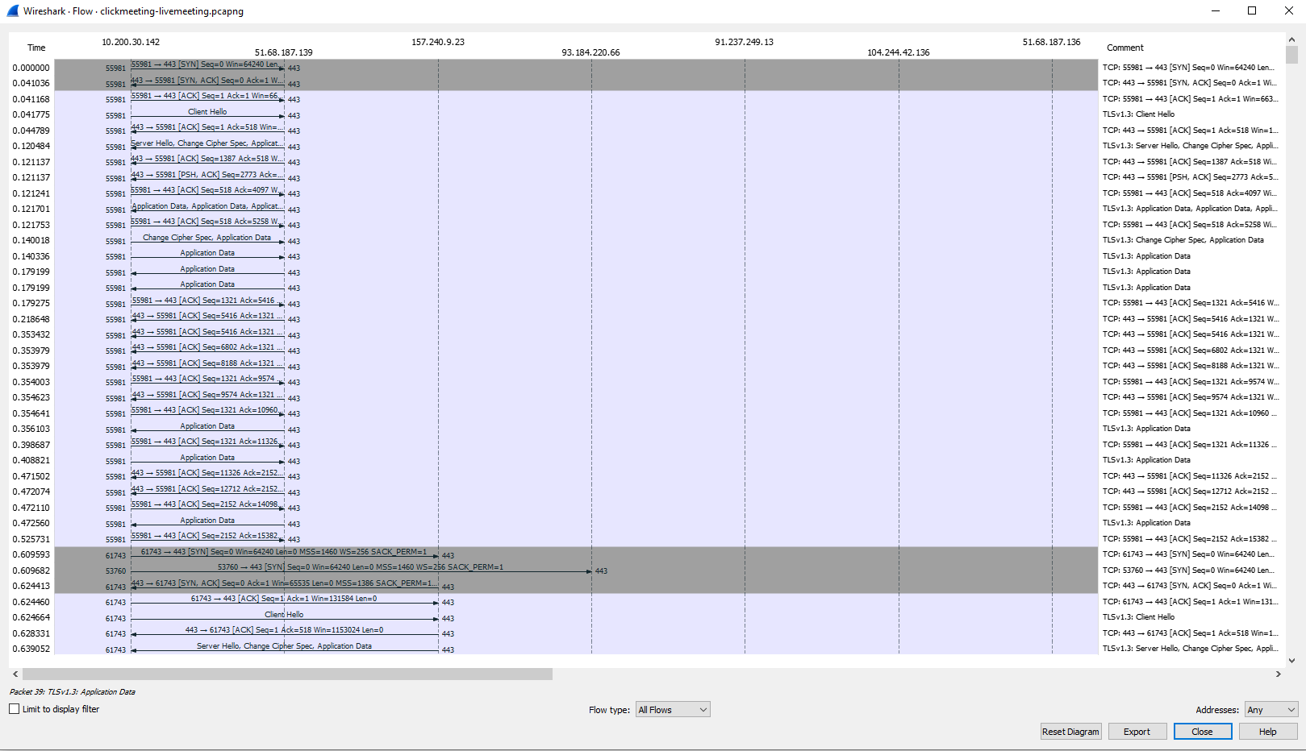
Flow Graph
Technologies
Setup
Live Meeting
Live Webinar
On-demand
Results
The Flow Graph window shows connections between hosts. It displays the packet time, direction, ports, and comments for each captured connection.
Notes:
As it stated in the slide, flow graph makes it easier to see communication between sources and destinations. With this way you can also see if is there any Proxy servers.

Slide 20
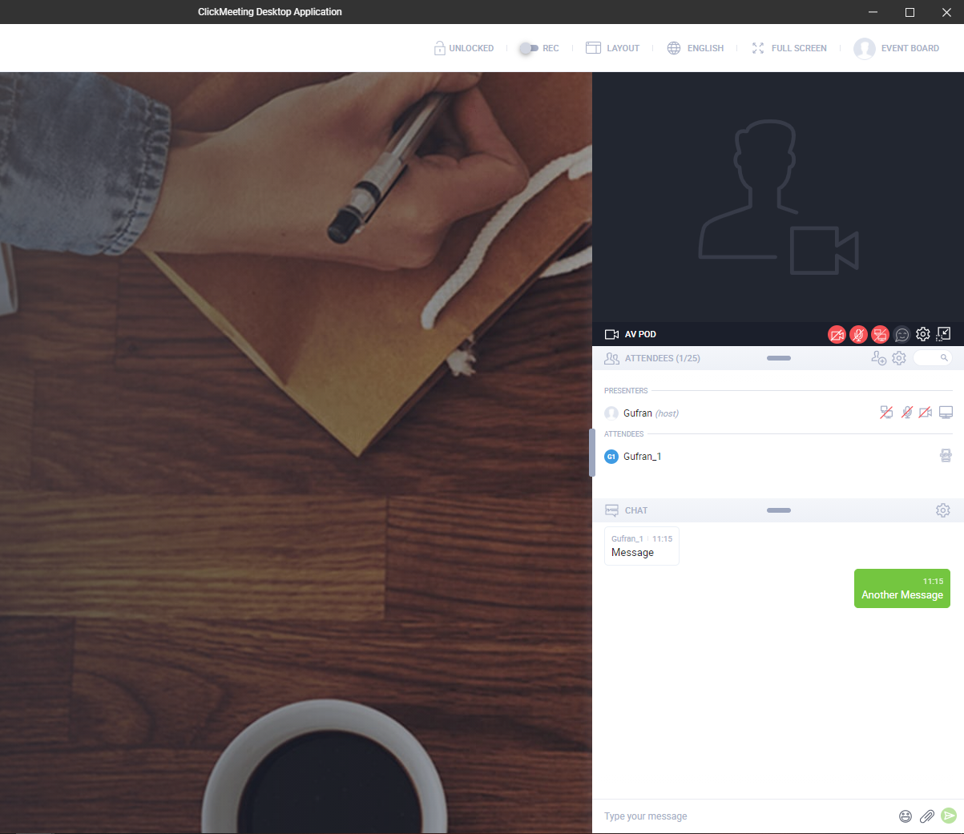
Technologies
Setup
Live Meeting
Live Webinar
On-demand
Results
04.
Live Webinar
Packet Behavior & Features
Notes:
Now let’s continue with the live webinars. I mostly introduced and described the features of graphs before so in this part we will be more familiar about what they are telling us.

Slide 21
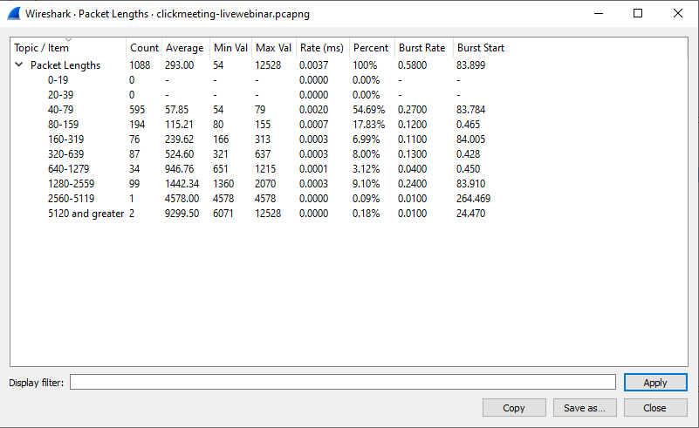
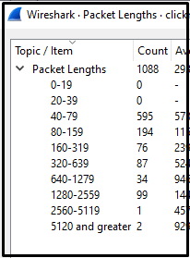
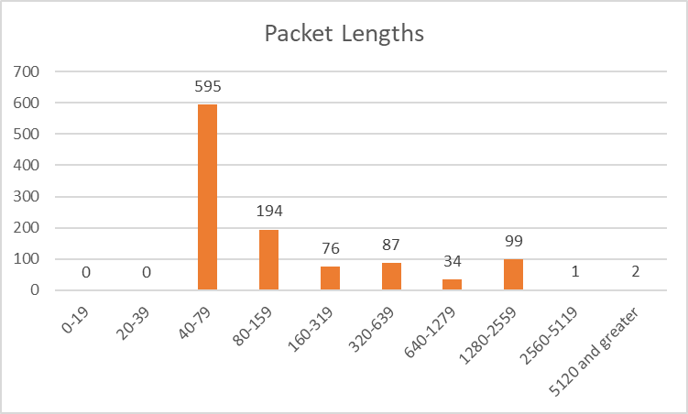
Packet Lengths
Technologies
Setup
Live Meeting
Live Webinar
On-demand
Results
Notes:
Not surprisingly, packets are similar to the Live Meeting. Why? Because they are not so different actually. Live webinars are just like live meetings but attendants can’t open their video or mic. Most of the other features are the same.

Slide 22
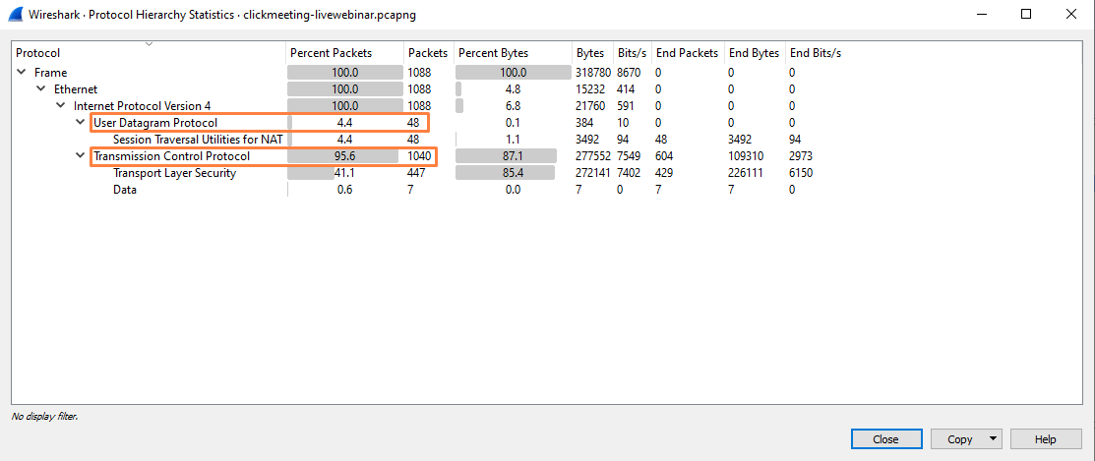
Protocol Hierarchy
Technologies
Setup
Live Meeting
Live Webinar
On-demand
Results
Notes:
There is one difference between Live meetings. There are not any packets by QUIC. I am not quite sure but I guess that the application may disable QUIC in Live Webinars due to security concerns.

Slide 23
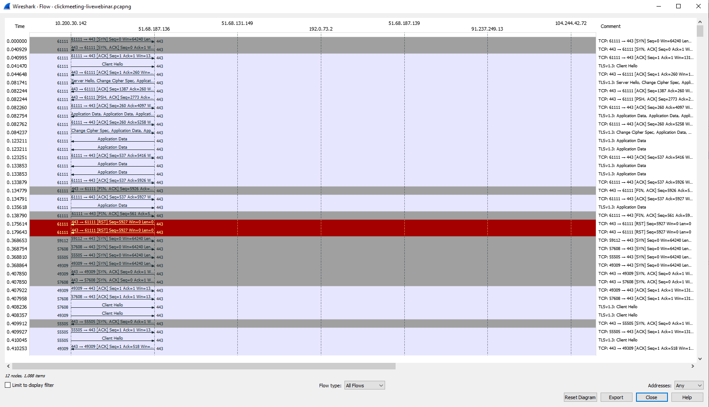
Flow Graph
Technologies
Setup
Live Meeting
Live Webinar
On-demand
Results
Thanks to the Flow Graph, it can be clearly observed which IP addresses are connected.
Notes:
We can see that connection established mostly between same IP addresses.

Slide 24
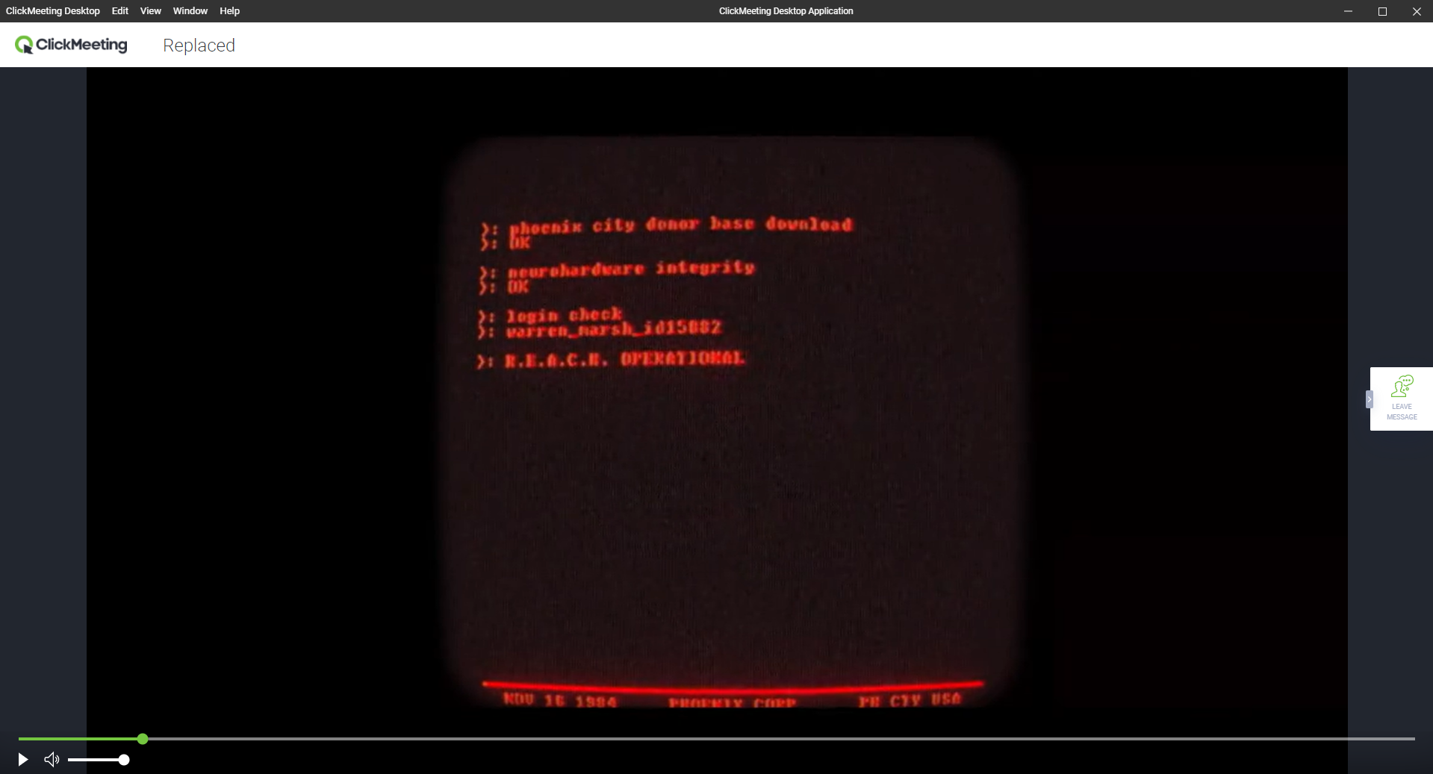
Technologies
Setup
Live Meeting
Live Webinar
On-demand
Results
05.
On-Demand Meeting
Packet Behavior & Features
Notes:
In this part, there will be differences. You can guess the reason behind this. Because it is not live. Attendants are just watching a video actually. I shared a 2K resouliton video but I guess platform streams it with HD quality.

Slide 25
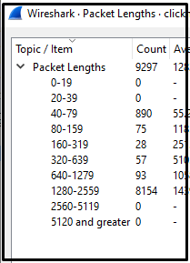
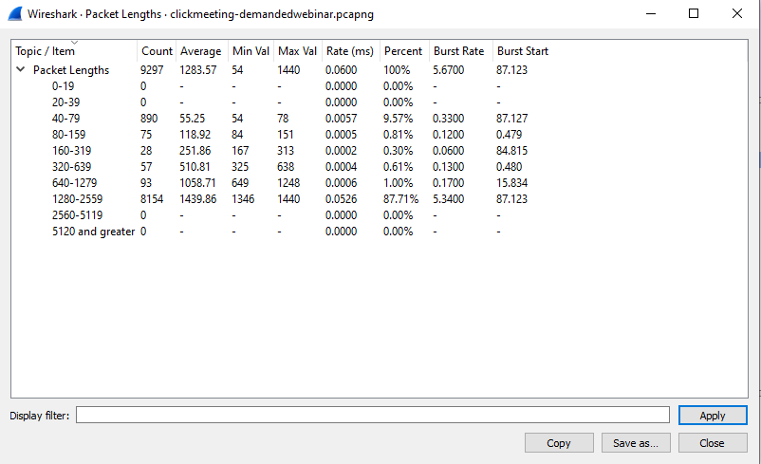
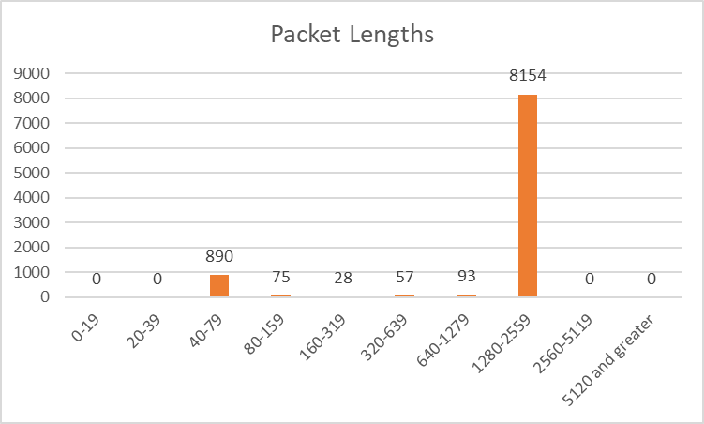
Packet Lengths
Technologies
Setup
Live Meeting
Live Webinar
On-demand
Results
Notes:
Packet lengths are radically increased. Even though I researched I couldn’t find any reasonable explanation for that because I would expect to send smaller packets with UDP while streaming video.

Slide 26
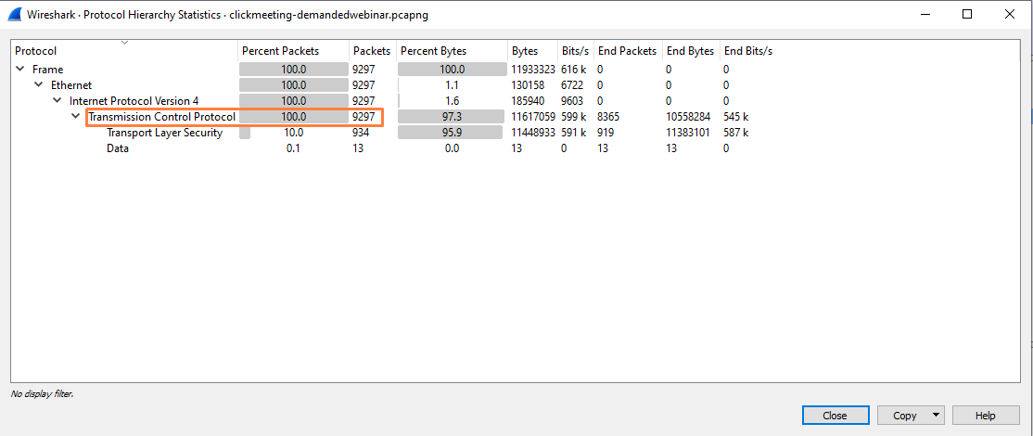
Protocol Hierarchy
Technologies
Setup
Live Meeting
Live Webinar
On-demand
Results
Notes:
All packets are transported over TCP. This may be because attendants just had to download the video and didn’t need to find the public address of the servers so didn’t use any STUN protocol.

Slide 27
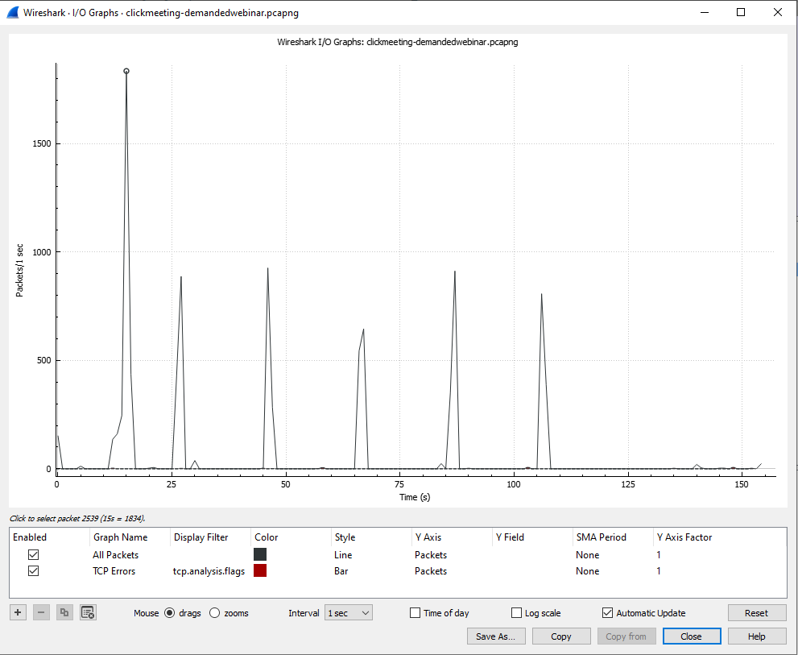
I/O Graph
Technologies
Setup
Live Meeting
Live Webinar
On-demand
Results
I/O Graphs let us plot packet and protocol data in a variety of ways.
Notes:
It looks clearer than live streams because packets are sent according to the buffer so there are spikes.

Slide 28

Flow Graph
Technologies
Setup
Live Meeting
Live Webinar
On-demand
Results
No communication with any IP address except local network and clickmeeting’s amazon servers as video is played from a single connection.
Notes:
This may be because I was the only attendant. But we can see a clear communication between just local network and the server.

Slide 29
Comparison
Technologies
Setup
Live Meeting
Live Webinar
On-demand
Results
Protocol Hierarchy
Packet Sizes
While there are data where UDP is used during live streaming, only TCP is used during the on-demand webinar.
While live-streaming voice and video calls, smaller packets are transported, but in video recording, the packets are much larger.
Notes:
As a result, let’s compare protocols and packet sizes. We can clearly see the differences between on-demand connections and live streams while there are similarities between live meetings and live webinars. Also, packet sizes were bigger for on-demand video sharing even though I don’t know the logical reason behind it.

Slide 30
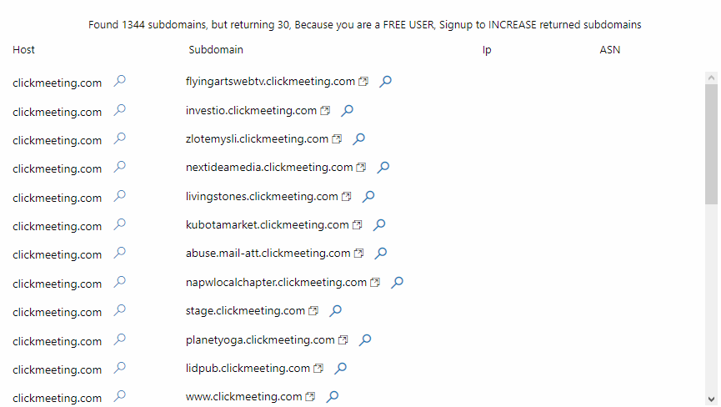
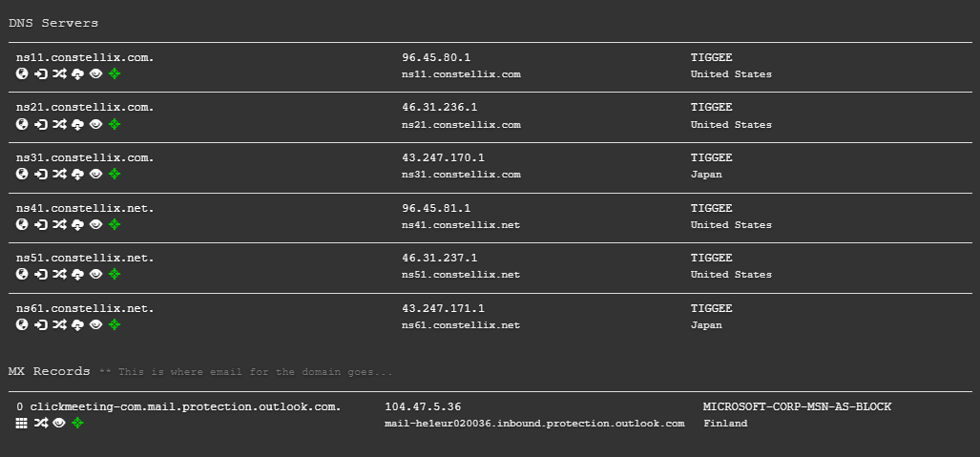
Servers - Subdomains
Technologies
Setup
Live Meeting
Live Webinar
On-demand
Results
Nmapper
DNS Dumpster
(Not Real Locations)
Notes:
At last, I scanned the IP addresses to find domain names. I have found some of the servers but more importantly this scan led to a vulnerability which is about subdomains. ClickMeeting creates subdomains for every user-created starting with their username. This may cause leaks about users’ personal information or phishing attacks.

Slide 31
To Sum Up
Technologies
Setup
Live Meeting
Live Webinar
On-demand
Results
Tech | Setup | Live Meeting | Live Webinar | On-Demand | Results
HTML5 - webRTC | Wireshark - Ports | Chat – Voice - Video | Chat – Voice - Video (Just Host) | Recorded Video | Comparison
Notes:
To sum up we can remember that HTML5 and webRTC have great importance on browsers. Then we set up our Wireshark with the guidance of our port scan. Then we inspected the features and network traffics of live and on-demand streams. In the end, we compared similarities and differences between packets and found a possible vulnerability at ClickMeeting.

Slide 32
Thanks!
Technologies
Setup
Live Meeting
Live Webinar
On-demand
Results
Presented by Gufran Yesilyurt
Notes:
Many thanks for your time and patience!

Slide 33
References
Technologies
Setup
Live Meeting
Live Webinar
On-demand
Results
Pertsev M. (2018), SYNCHRONOUS LEARNING IN ONLINE COURSE: A NECESSITY OR CHOICE?
About ClickMeeting. (2022, March 18). Help Center Clickmeeting. https://knowledge.clickmeeting.com/faq/what-technology-does-clickmeeting-use/
HTML5 media. (n.d.). O’Reilly Online Learning. https://www.oreilly.com/library/view/html5-media/9781449308063/ch01.html
WebRTC. (2013, October 15). High Performance Browser Networking. https://hpbn.co/webrtc/
WebRTC – architecture & protocols. (2017, August 19). P's Blog. https://princiya777.wordpress.com/2017/08/19/webrtc-architecture-protocols/
Markruss. (2022, January 27). TCPView for Windows - Windows Sysinternals. Developer tools, technical documentation and coding examples | Microsoft Docs. https://docs.microsoft.com/en-us/sysinternals/downloads/tcpview
Notes:
Here are the references that helped me while doing this inspection.

